Slide 1
Physics 1 – Nov 2, 2018
P3 Challenge –
Today’s Objective: Second Law Problem Solving (frictionless)
Get out Forces homework p4 for check

Slide 2
Agenda, Assignment
IB 2.2 Forces
Second Law Problems (frictionless)
Agenda
Homework review
Kinematics and the second law
General Second Law Problem solving
Sample problem
Practice
Assignment:
Second Law Problems Worksheet

Slide 3
Kinematics and Dynamics
Variable in common to both kinematics and dynamics is acceleration.
Ex: What average force is needed to accelerate a 7.00 g bullet from rest to 175 m/s over a distance of 0.700 m along the barrel of a rifle?
Ex: A 10. kg bucket is lowered by a rope in which there is 63 N of tension. What is the acceleration of the bucket? Is it up or down? How long before the bucket hits the water 13 meters below?

Slide 4
Typical Second Law Problem Solving
1) Draw the system. Label with masses and Forces and any other data.
2) Choose the body of interest (to be treated as a point mass) and a frame of reference.
3) Draw the Free Body Diagram, including all forces acting on the body of interest. Include the direction for each.
4) Resolve all forces at an angle into their x and y components.
5) Write the expression for the net force in each dimension (F_{net,x} = Right – left, F_{nety} = Up – down)
6) Write the second law equation for each dimension F_{net,x} = ma_{x} F_{nety} = ma_{y}
7) (Opt first or last step) Connect to kinematics through acceleration.

Slide 5
Sample 2nd Law Problem
A 21 kg child on a 16 kg sled is being dragged over “frictionless” snow by a rope that makes a 30° angle to the horizontal. What is the tension in the rope when the sled is taken from rest to a speed of 1.3 m/s in 3.5 seconds?

Slide 6
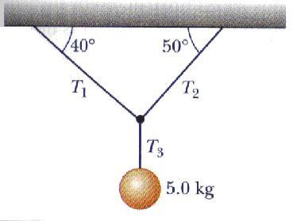
Sample 2nd Law Problem
Determine the three tensions.

Slide 7
Exit Slip - Assignment
How do you write the second law equation in the x dimension? In the y dimension?
What’s Due on Nov 2? (Pending assignments to complete.)
Complete the 2nd law worksheet
What’s Next? (How to prepare for the next day)
Read p57-75

